Slide 1
Date-A-Thon
LET’S LOVE
Problem: Make a web application that assist couples in celebrating their union, whether in person or virtually.
Present By:
The Wizer’s

Slide 2
ABOUT OUR WEBSITE
We try to make this website according to the given problem. It is only a frontend work or better we say an user interface. It is basically in the ideation phase.

Slide 3
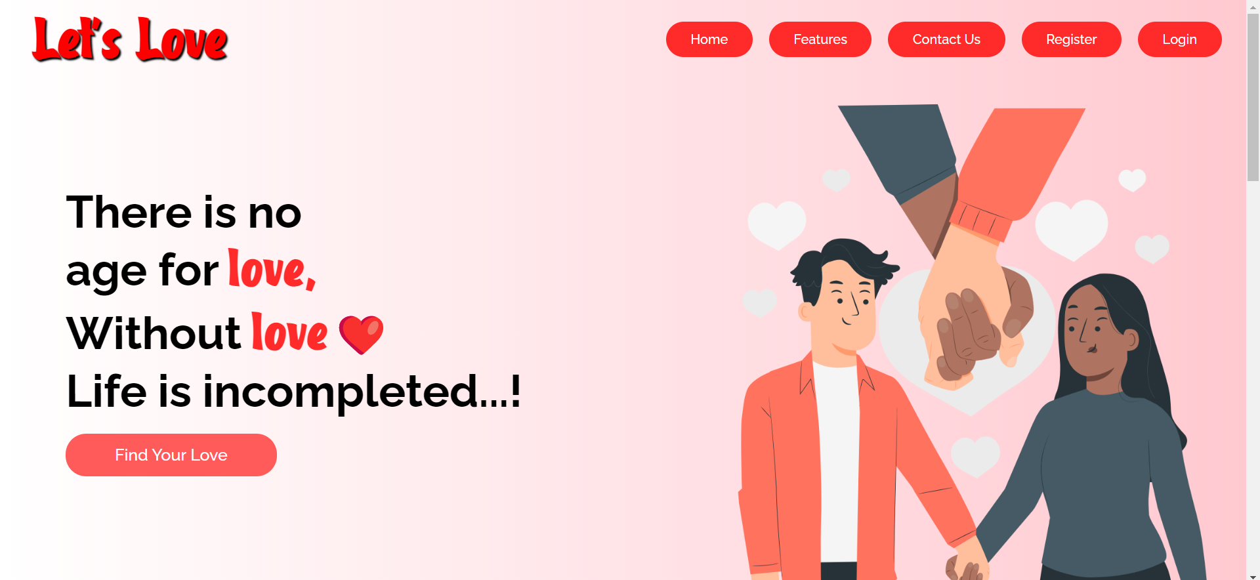
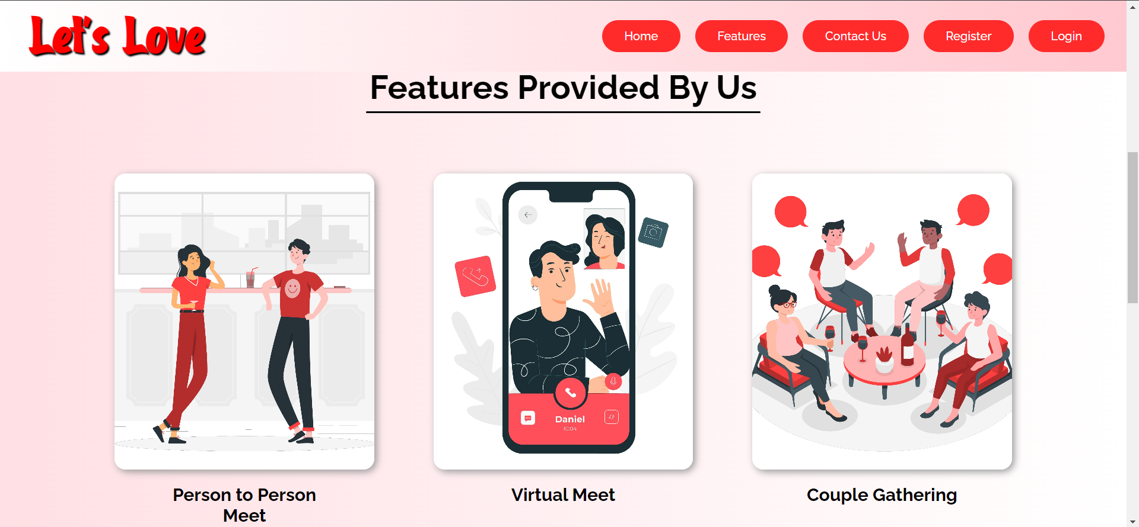
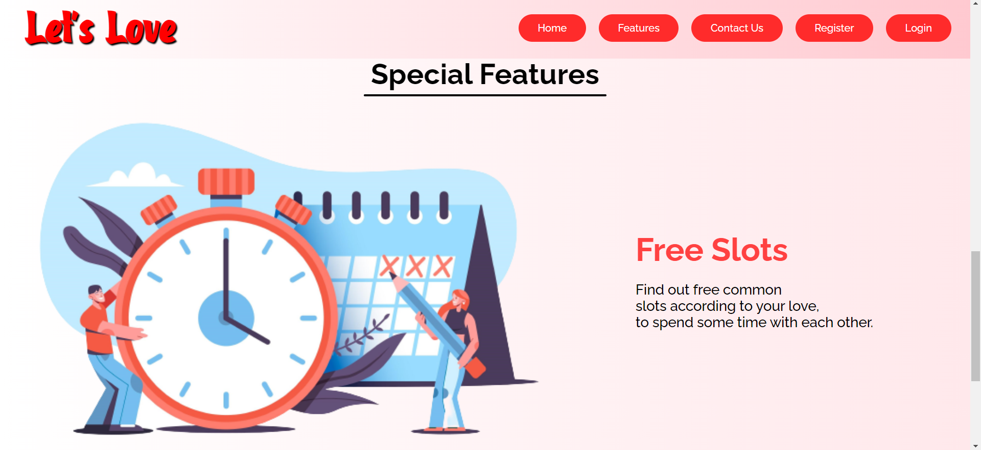
THE LANDING PAGE
Our website LET’S LOVE has a landing page that describe the overview of our overall website’s that basically deals with the dating problem that are facing nowadays.

Slide 4
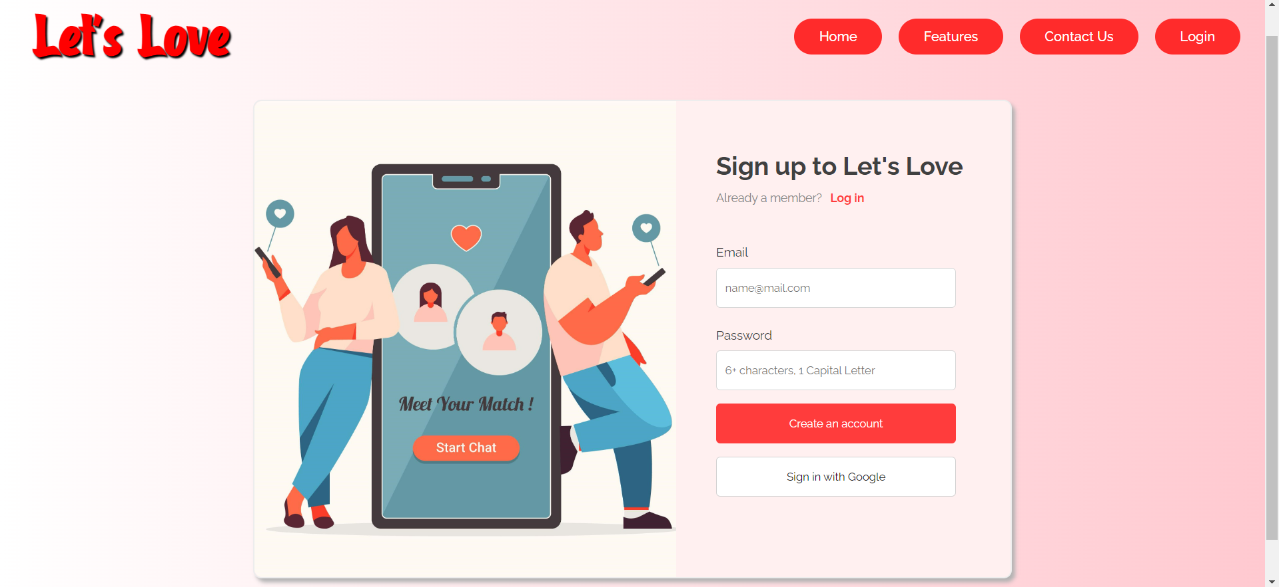
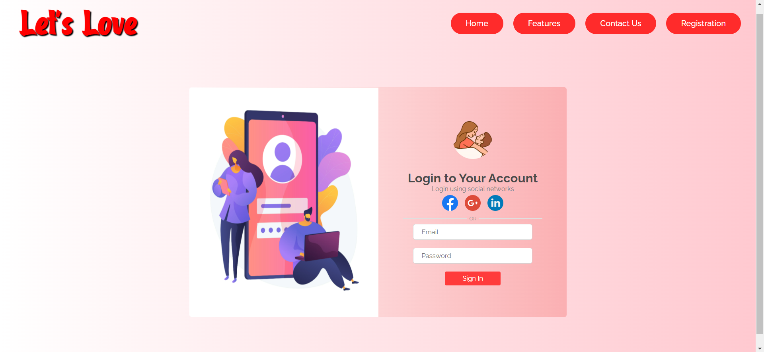
REGISTER AND LOGIN PAGE
Once the user get registered, he/she is able to access the various profiles according to his/her choices like the skills, hobbies, etc.

Slide 5
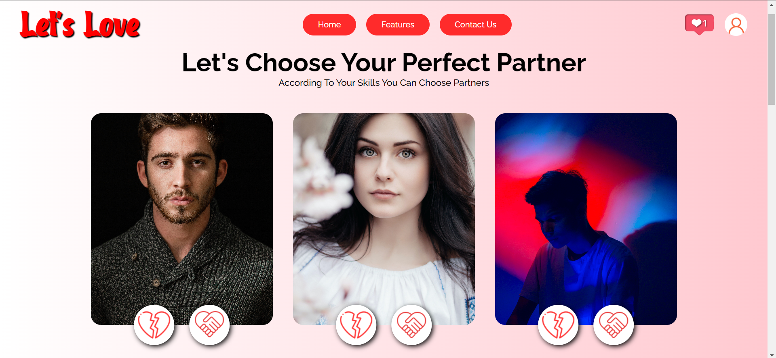
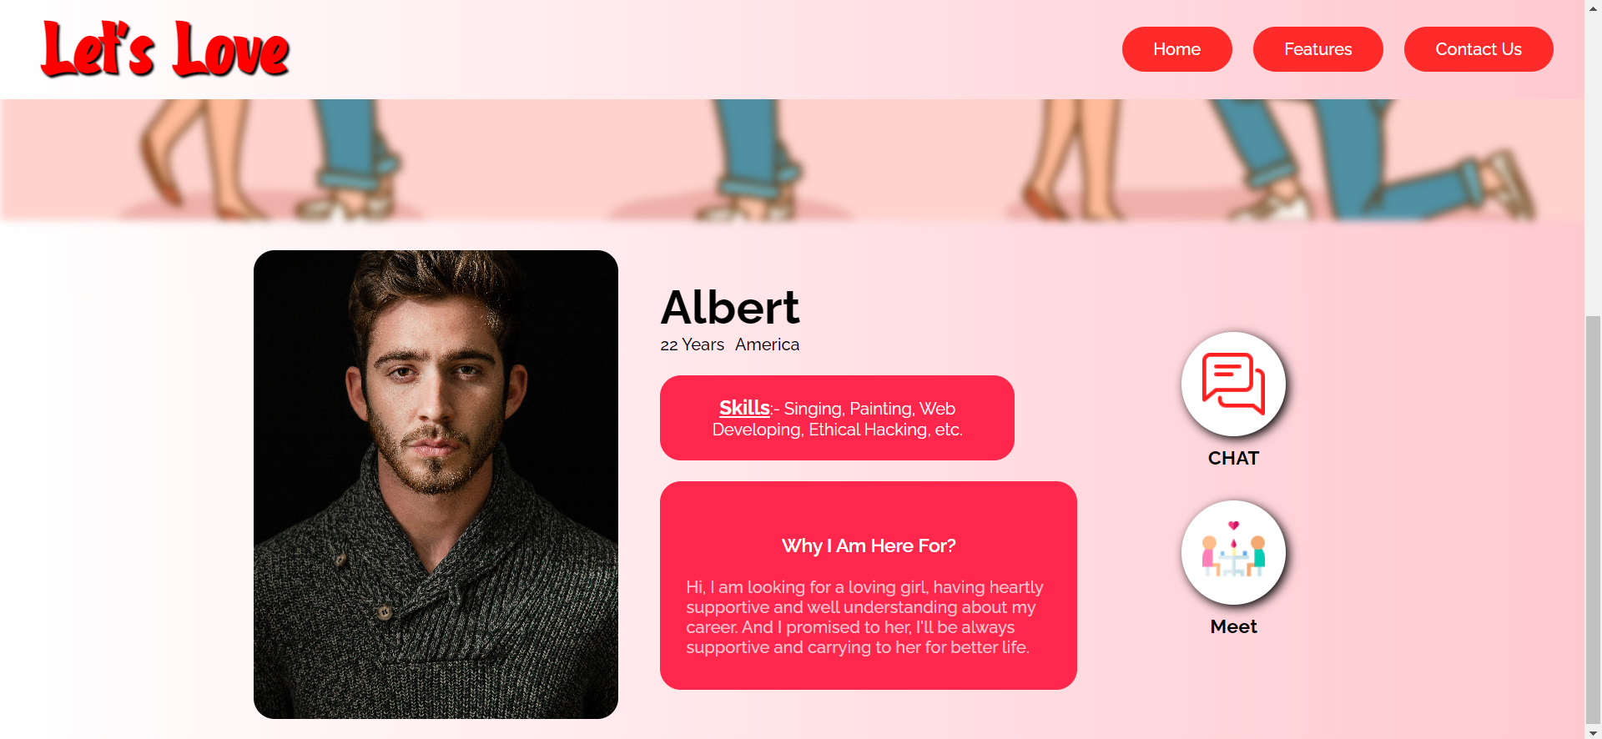
OVERALL PROFILE LOOK

Slide 6
THANK YOU

